Slide 1

Recipe Generator
Creating a Cooking Recipe Generator Using AI Prompts

Slide 2

Introduction
This presentation explores various prompting techniques to generate cooking recipes using AI, focusing on Zero-shot, Few-shot, and Chain-of-Thought methods.

Slide 3

Zero-shot Prompting
01

Slide 4
Definition and explanation
Zero-shot prompting involves providing a prompt to an AI model without any prior examples. The model relies on its pre-trained knowledge to generate content based on the given inputs.

Slide 5
Example with ingredients
For instance, if the user prompts, "Generate a cooking recipe using the following ingredients: chicken, garlic, lemon, olive oil," the AI will produce a recipe from its existing knowledge without needing any reference examples.

Slide 6
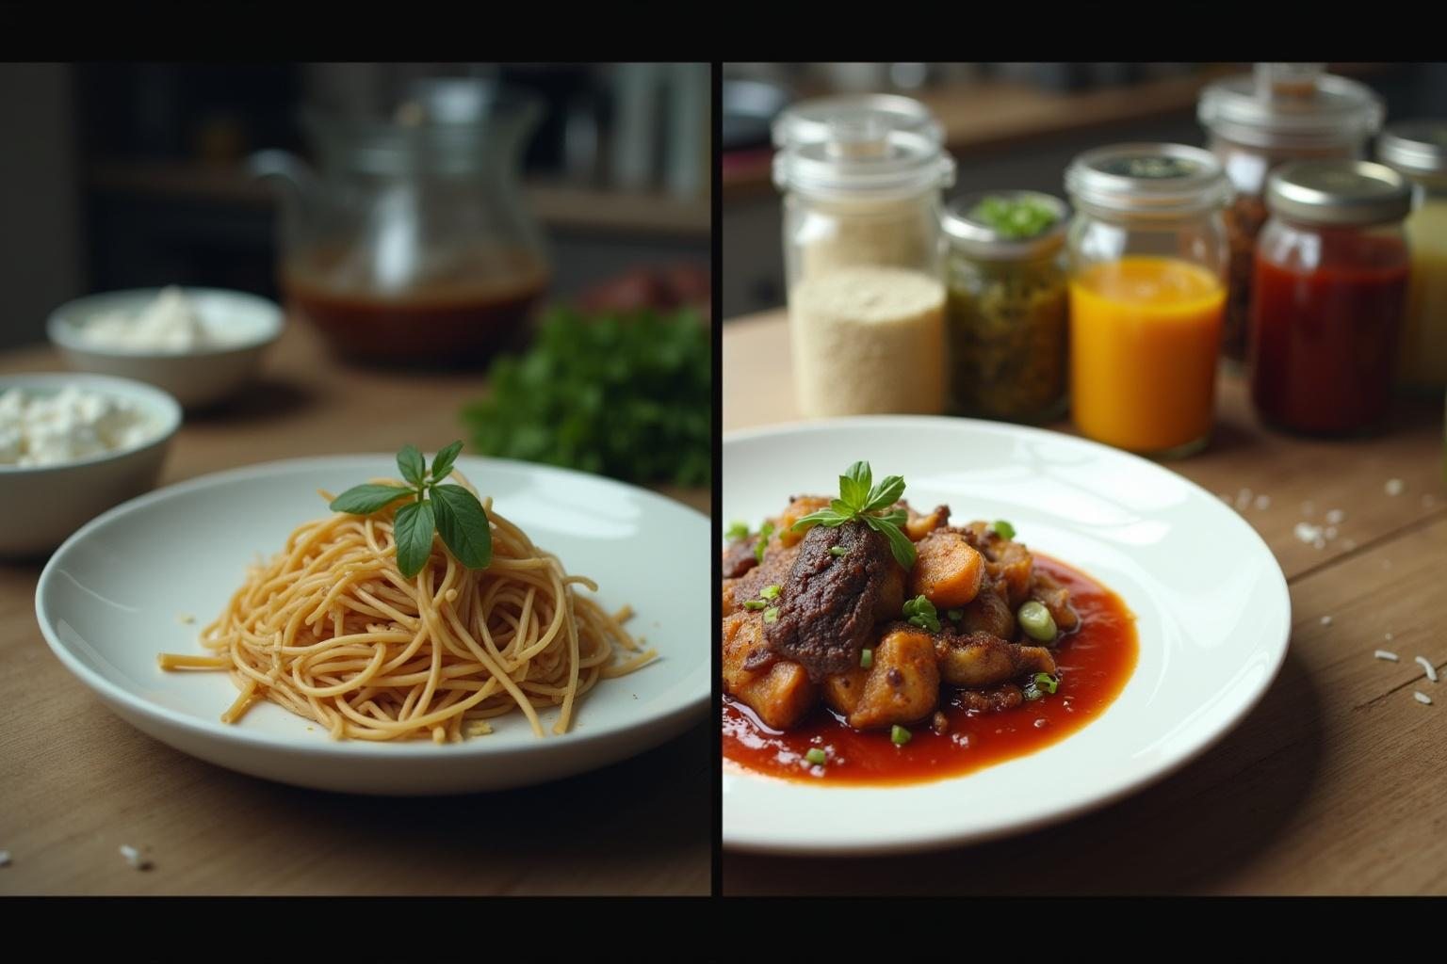
Advantages and limitations
This approach is efficient for quickly generating recipes; however, it may lack detail and specificity in the output since it does not guide the AI with context or structure.

Slide 7
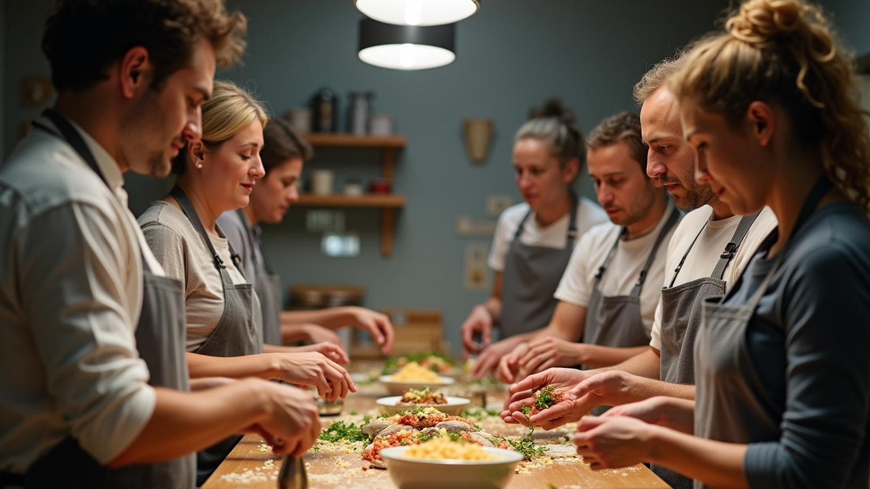
Few-shot Prompting
02

Slide 8
Definition and comparison
Few-shot prompting involves supplying the AI with example prompts and desired outputs, enabling it to understand the specific format and style required. This technique contrasts with zero-shot prompting, where no examples are provided.

Slide 9
Example with structured response
In few-shot prompting, the user might present a structure like: 'Q: Ingredients: tomato, basil, mozzarella; A: Caprese Salad.' Following this, the AI can use its understanding to generate a recipe based on similar ingredients.

Slide 10

Benefits of using examples
By providing examples, the AI is better guided to produce responses that follow desired formats. This method increases the likelihood of generating high-quality outputs that meet specific user needs.

Slide 11

Chain-of-Thought Prompting
03

Slide 12
Overview of the approach
Chain-of-thought prompting encourages the AI to articulate its reasoning process step-by-step. This method involves asking the AI to consider various factors such as flavor, cooking methods, and presentation before producing a recipe.

Slide 13
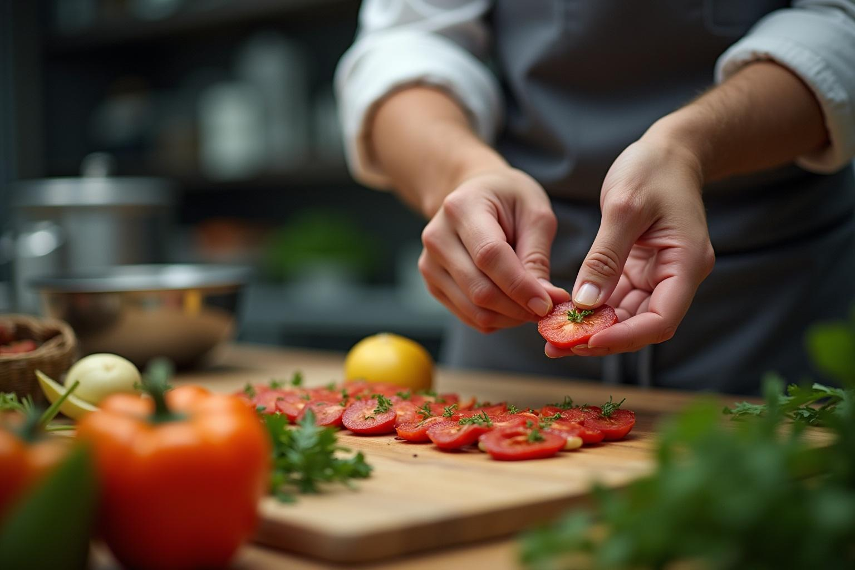
Step-by-step reasoning process
For example, a prompt might read: 'Using the ingredients, think through how to create a recipe step-by-step.' This leads the AI through deliberation on ingredient interactions and cooking techniques.

Slide 14
Outcomes of enhanced output
This technique often results in more thoughtful and nuanced recipes. By engaging in a reasoning process, the AI can offer detailed instructions and a comprehensive understanding of the culinary creation.

Slide 15
Conclusions
Each prompting technique—zero-shot, few-shot, and chain-of-thought—has unique advantages. Utilizing these methods effectively can greatly enhance the quality and creativity of AI-generated recipes.

Slide 16
Thank you
Hema Nagalla

